Slide 1



ASP.NET Core with visual studio code
.NET 10
By Gan leng keong

Slide 2

Development environment setup
1. Open the terminal (Ctrl+J)
2. Type donet --version and hit enter key

Slide 3
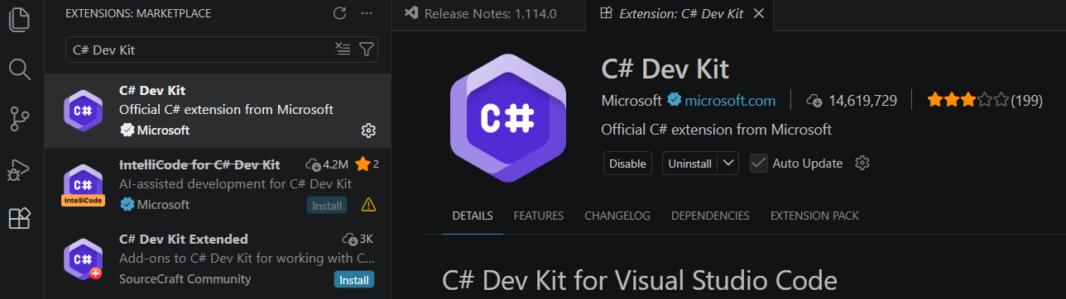
Development environment setup
2. Search for “C# Dev Kit”
3. Click on this
4.Click for install
1. Click on Extension icon

Slide 4
Setting up .net project
View > Command Palette… (Ctrl+Shift+P)
.Net: New Project
ASP.NET Core Empty
Select the project folder
GameStore.API
.slnx
Create Project

Slide 5
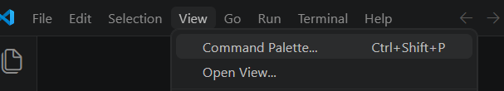
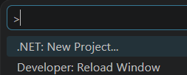
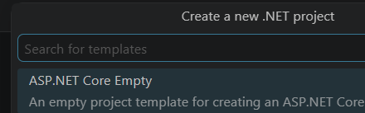
Setting up .net project
View > Command Palette… (Ctrl+Shift+P)
Click on “.NET: New Project…”
Click on “ASP.NET Core Empty”

Slide 6
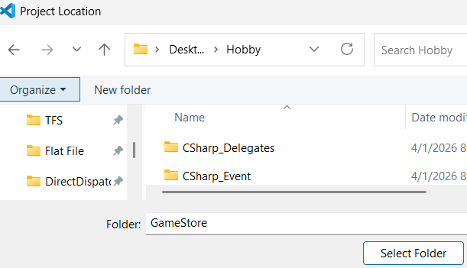
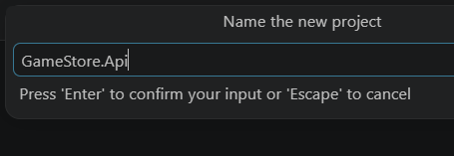
Setting up .net project
Choose the project folder (GameStore)
Name the project

Slide 7
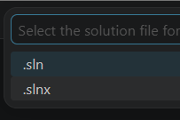
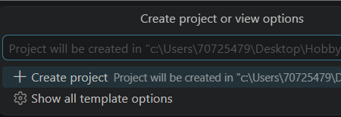
Setting up .net project
Choose .slnx
Click on the “Create Project”

Slide 8
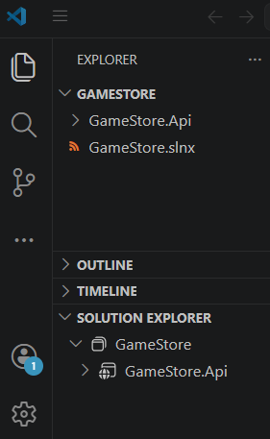
Setting up .net project
Project structure look like after creating it

Slide 9
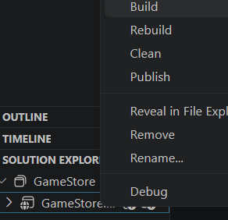
Building and running .net project
Build Option#1
2. Select build option
1. Right click the solution in Solution Explorer

Slide 10
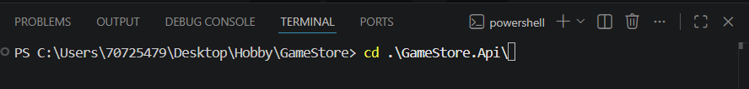
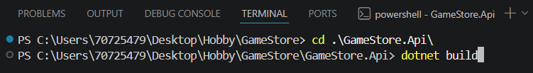
Building and running .net project
Build Option#2
1. Switch to the solution path
2. Building the solution

Slide 11
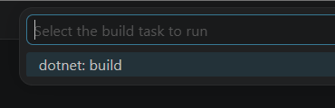
Building and running .net project
Build Option#3
1. Ctrl + Shift +B and select dotnet: build

Slide 12
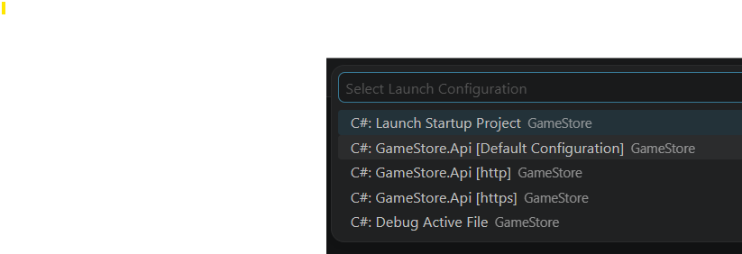
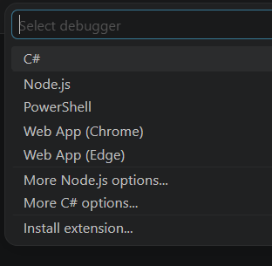
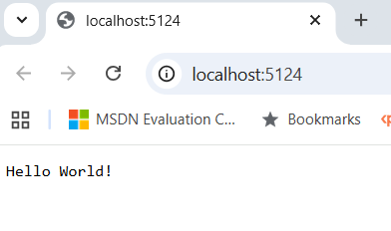
Building and running .net project
2. Select the http option
Run application #1
1. Press F5 and select C#
The output once finish run the application

Slide 13
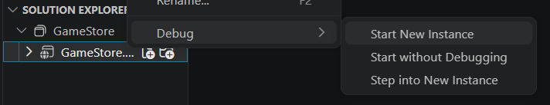
Building and running .net project
Run application #2
Right click the project and select Debug > Start New Instance
Choose this option to avoid debug

Slide 14
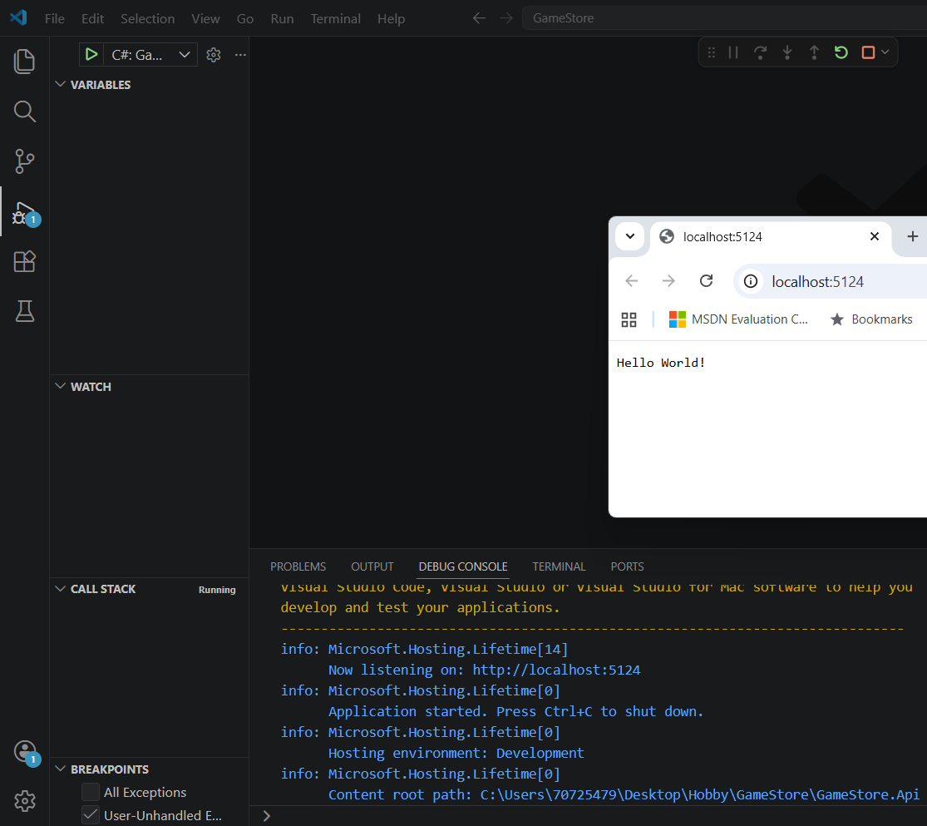
Building and running .net project
Run application #3
Press Ctrl+F5 at visual studio code

Slide 15

Building and running .net project
Run application #4
Change to the project directory and use dotnet run
Press Ctrl + C to stop the run

Slide 16
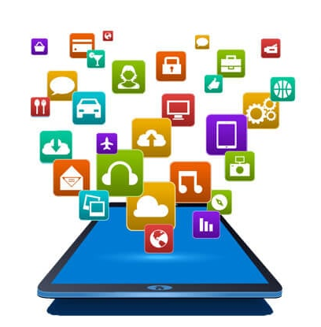

What is a rest api?
Application
Programming
Interface
Get Data through API
Applications
Cloud server

Slide 17
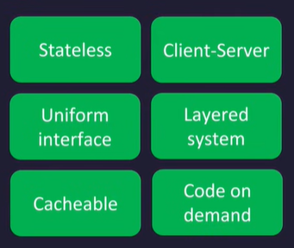
What is a rest api?
REpresentational
State
Transfer
A set of guiding principles that imposes conditions on how an API should work

Slide 18
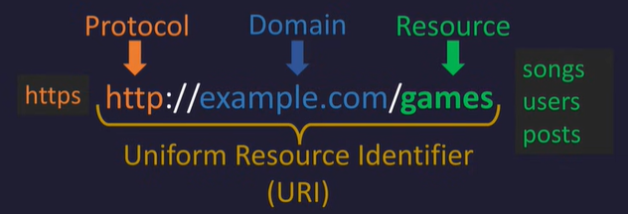
How to identify resource in a rest api?

Slide 19
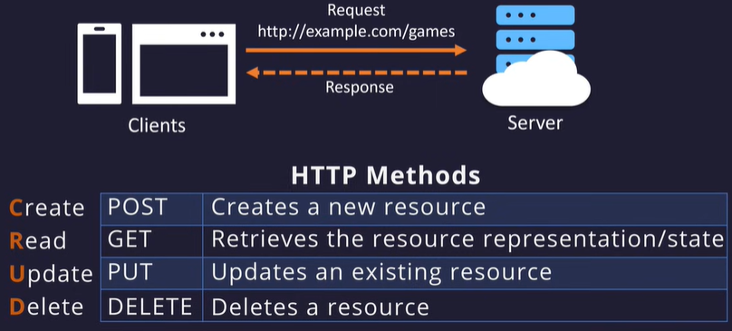
How to interact with a rest api?

Slide 20
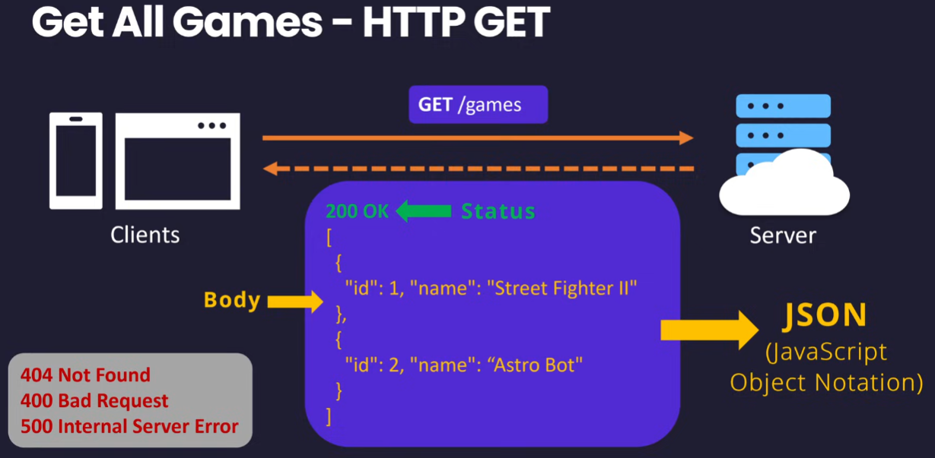
Get all games – http get
Other status that returned

Slide 21
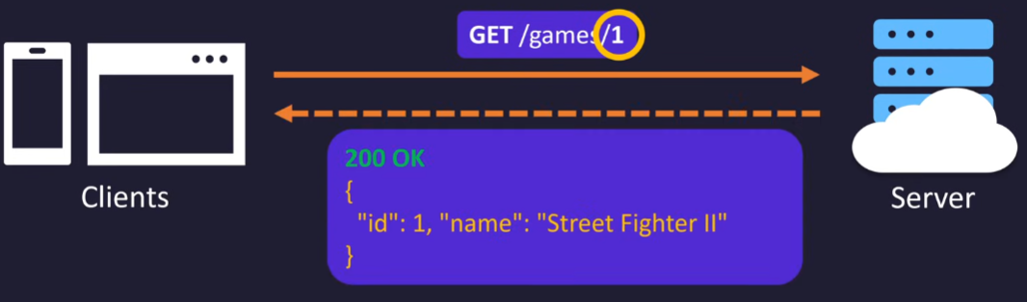
Get a specific game – http get
Id of the game

Slide 22
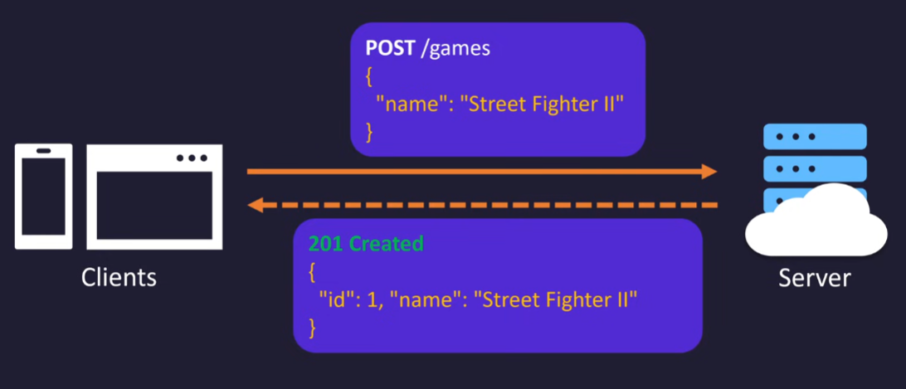
Create a game – http post

Slide 23
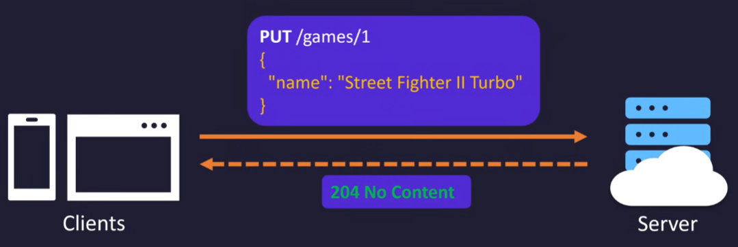
Update a game – http put

Slide 24
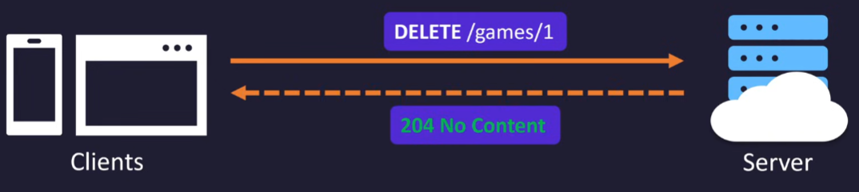
Delete a game – http delete

Slide 25
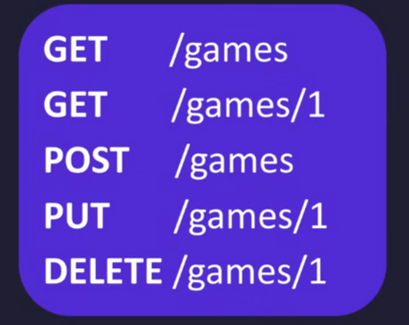
Summary of Games rest api
Get all games
Get specific game
Create new game
Update specific game
Delete specific game

Slide 26
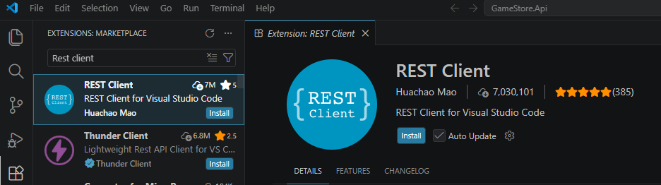
Installing extension: rest client
2. Search for REST Client
3. Click on this
4. Click for install
1. Click on the extension icon

Slide 27
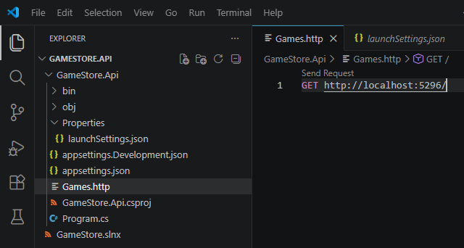
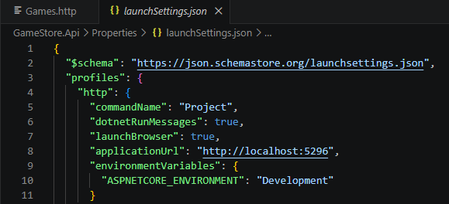
How to use the extension
2. Write this line
1. Create the Games.http file

Slide 28
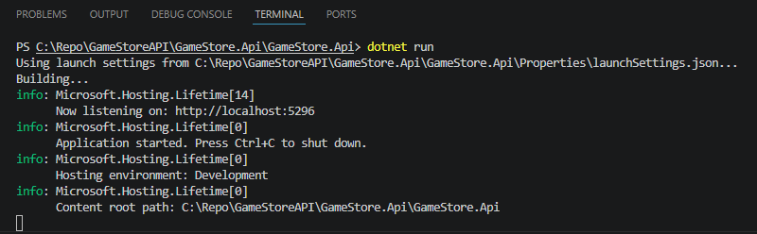
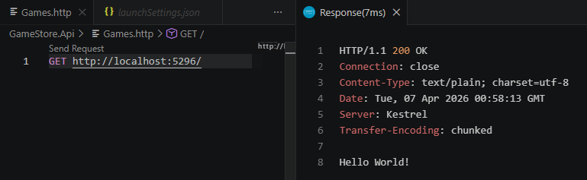
How to use the extension Continue…
3. Perform dotnet run
5. Response is showing here
4. Click the Send Request

Slide 29
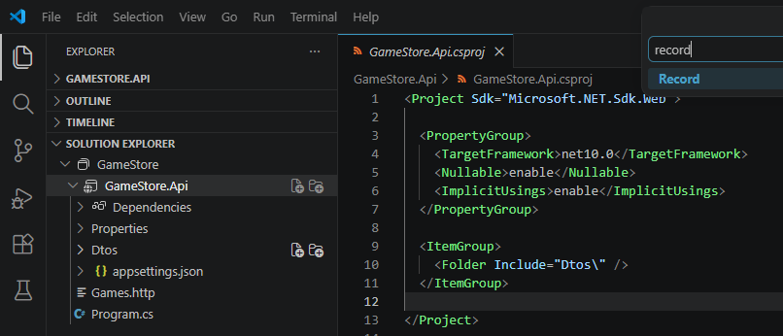
Creating DTOs
2. Right click Dtos folder and add new file of record template (GameDto.cs)
1. Add Dtos folder at Solution explorer

Slide 30
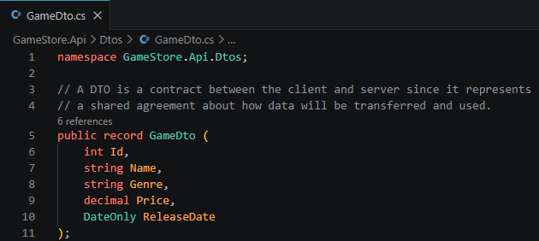
Data transfer object (dto)

Slide 31
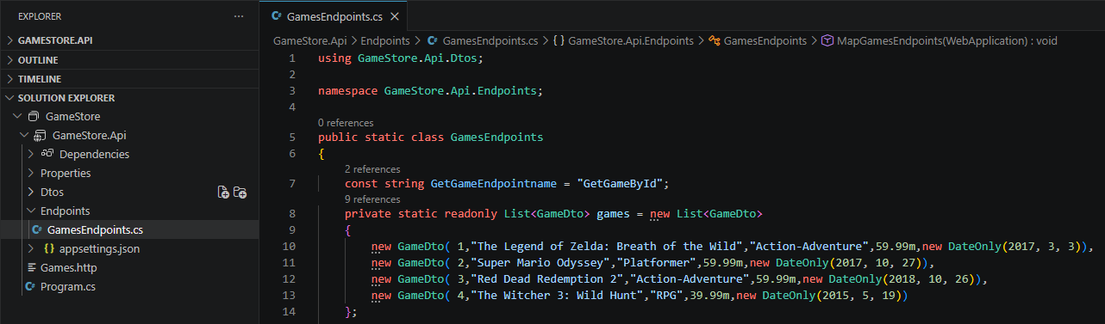
Create a list of games
Sample data

Slide 32
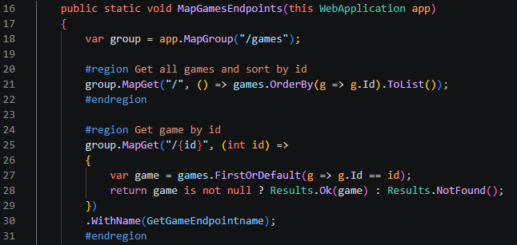
Game Endpoints
Get all games
Get specific game by Id

Slide 33
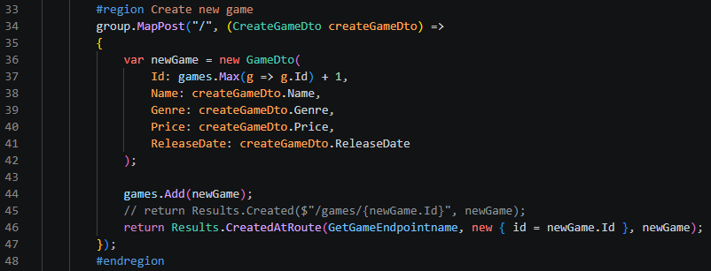
Game Endpoints continue
Create new game

Slide 34
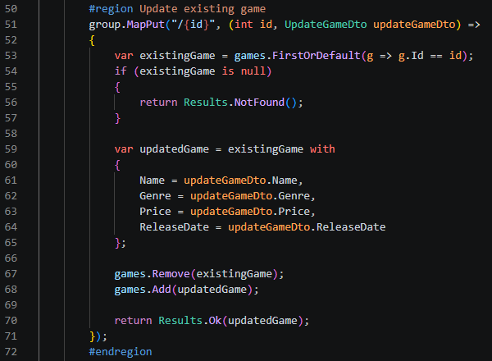
Game endpoints continue
Update existing game

Slide 35
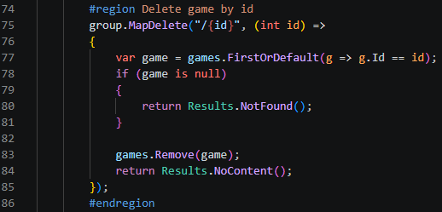
Game endpoints continue
Delete game by id

Slide 36
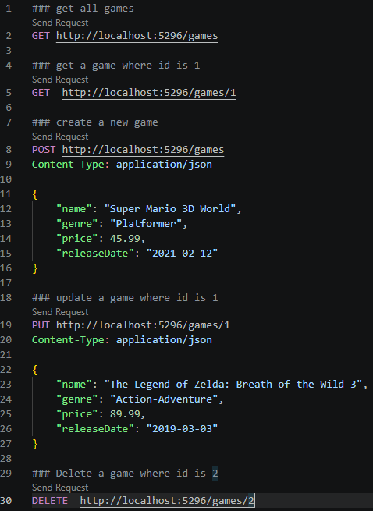
Rest client update
Need have one empty row

Slide 37
Adding validation on input

